Slide 1
Category review: Chips
August 29
Retail Analytics

Slide 2
Notes:
To view Privacy video explaining how important data privacy is to Quantium, please click here: https://www.youtube.com/watch?v=Zq1QDAkoRzU
or here Q:\Company Reference\Brand & Design\Brand videos\Q Privacy.mp4
At Quantium, we believe that data is the behavioural footprint of humanity and that it has to be treated with the utmost care and responsibility.
Histories, attitudes, indeed lives are stored within it in ways that aren’t always apparent – and that’s what makes its potential so powerful.
To work with it responsibly, sensitively, we set ourselves the highest data privacy protection and governance standards.
We have spent 17 years perfecting privacy-by-design and secure-by-design principles. Central to this is not holding any personally identifiable information about people –
we neither receive it, and put the necessary protections in place to be unable to decipher it.
Every aspect of handling data is safeguarded: from its de-identification, to its encryption – data security is paramount and of the highest grade.
We pride ourselves on gaining the trust of iconic organisations around the world through years of securely working with their data,
and in turn the trust that builds with their stakeholders.

Slide 3
Executive summary
01
Chips Category Review
The three highest contributing segments to total sales are: 1. Budget older families, 2. Mainstream young
singles/couples, 3. Mainstream retirees.
Factors driving sales: older families have largest avg no of packets purchased per customer, while the
mainstream young singles/couples have the largest population
To target in the store strategy: mainstream young singles/couple are more likely to purchase Tyrells chips than
other segments.
02
Store Analysis
STORE_NBR 77 outperforms its control STORE_NBR 233 in sales and driver for this seems to be more customer acquisition rather than transaction per customer.
STORE_NBR 86 slightly outperform its control STORE_NBR 196 even with low transaction per customer by leveraging the more customers acquisition.
Due to the maximum difference in the total sales of all the trial stores, STORE_NBR 88 remains the best implementation of the trial.

Slide 4
01
Chips Category Review

Slide 5
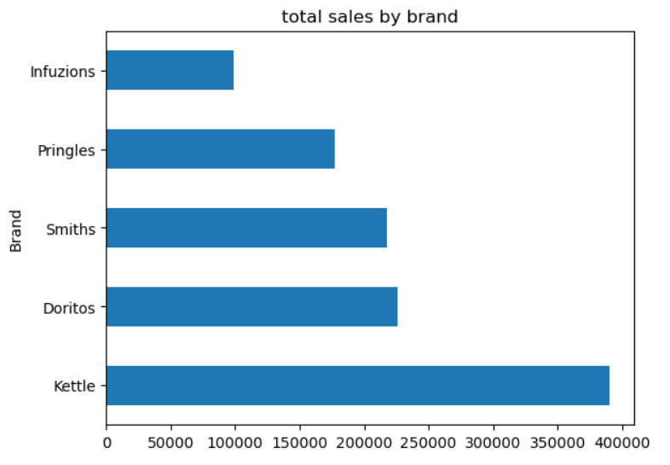
Most sold Brand is Kettle which lead by 50% from second most popular brand.

Slide 6
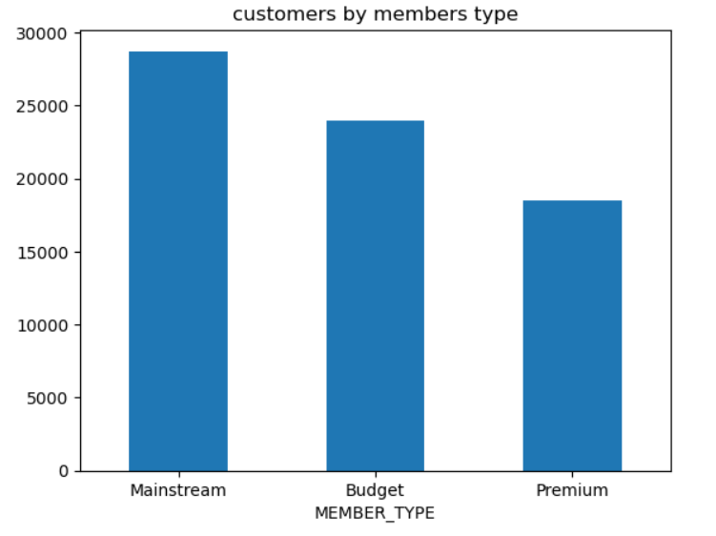
Most of the customers are the Mainstream member type while Premium are least in number
High sales in Mainstream is due to large customer base.

Slide 7
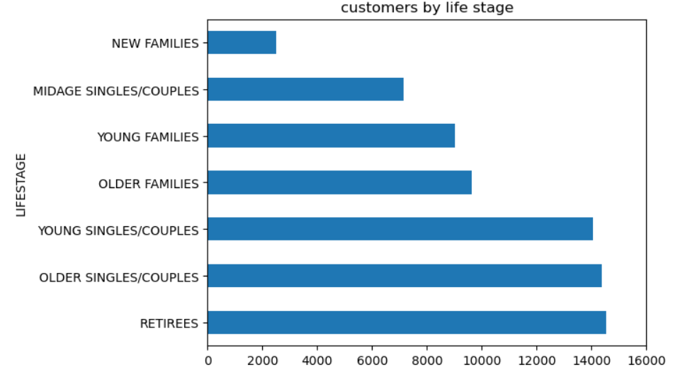
Retirees, older and young singles/couples are major part of the customer base.

Slide 8
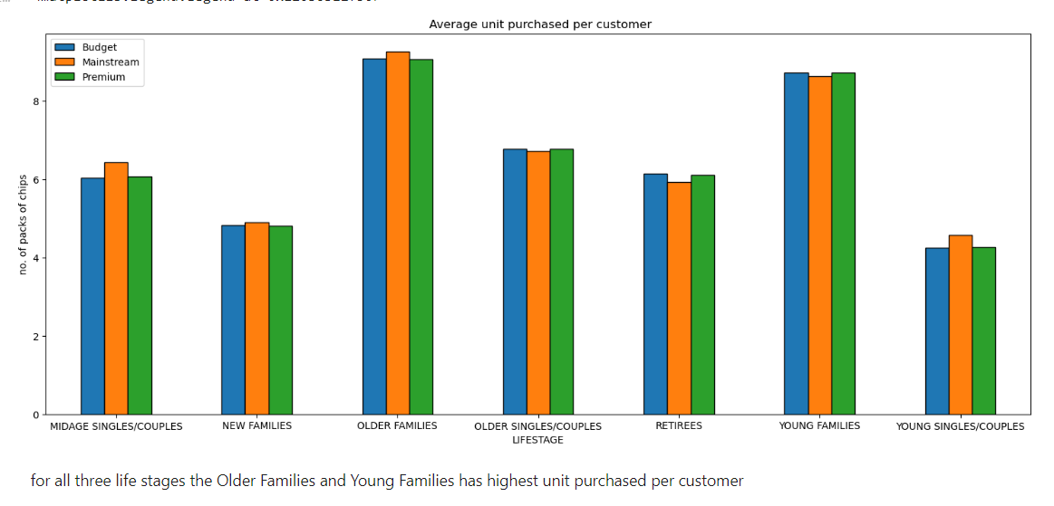
Sales mainly came from Budget - older families, Mainstream - young singles/couples, and Mainstream - retirees. In total contributing 25% of sales revenue.
Older and Young Family segment have the highest average purchase units per unique customer

Slide 9
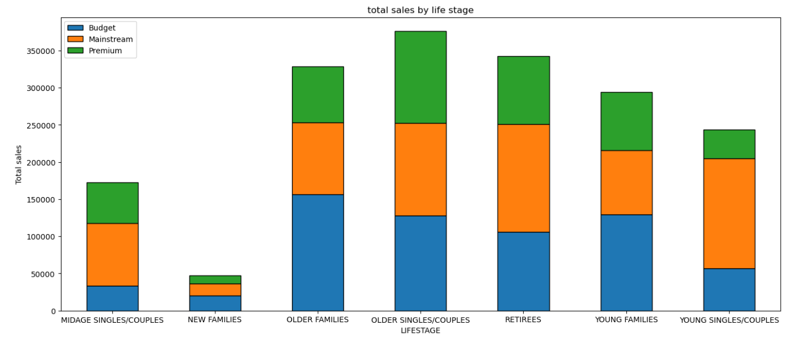
Sales mainly came from Budget - older families, Mainstream - young singles/couples, and Mainstream - retirees. In total, older customers buy more than younger customers. Non-premium customers buy more than premium customers.

Slide 10
02
Trial store performance

Slide 11
Before trial period
Pearson correlation coefficient of the attributes between the trial stores and rest to find the control stores for each of the trial store
Total sales, total customers and transaction per customer are the attributes used to select the control stores.
Comparing these the following stores are selected as control for each of the trial store.
Trial store 77: Control store 233
Trial store 86: Control store 196
Trial store 88: Control store 237

Slide 12
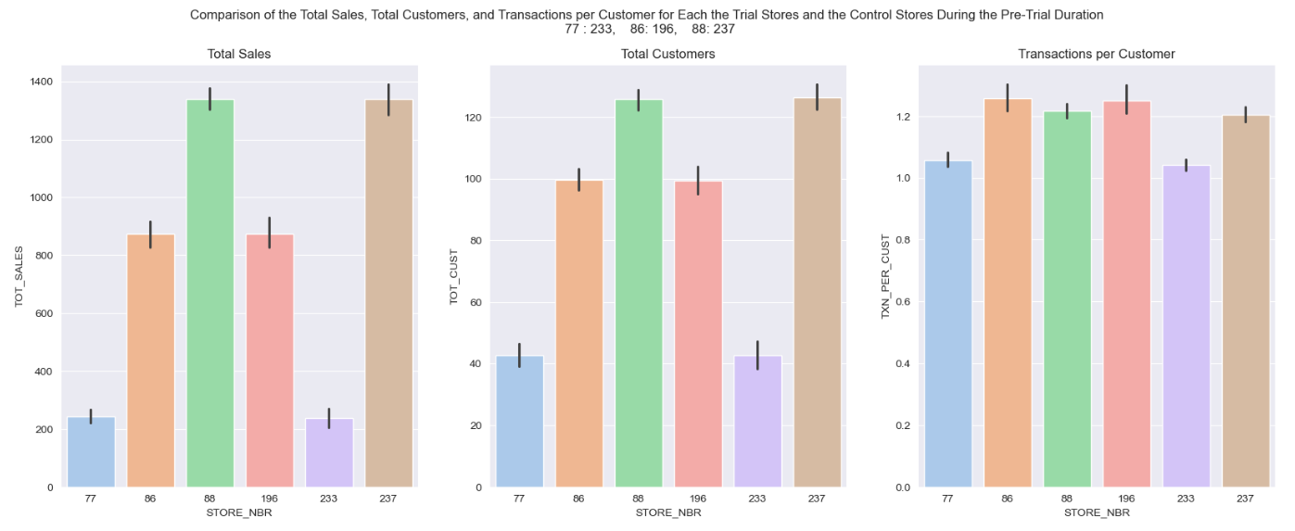
Before trial period
For each trial store and control store pair the total sales, total customers and transactions per customers are more or less similar during the pre trial period.

Slide 13
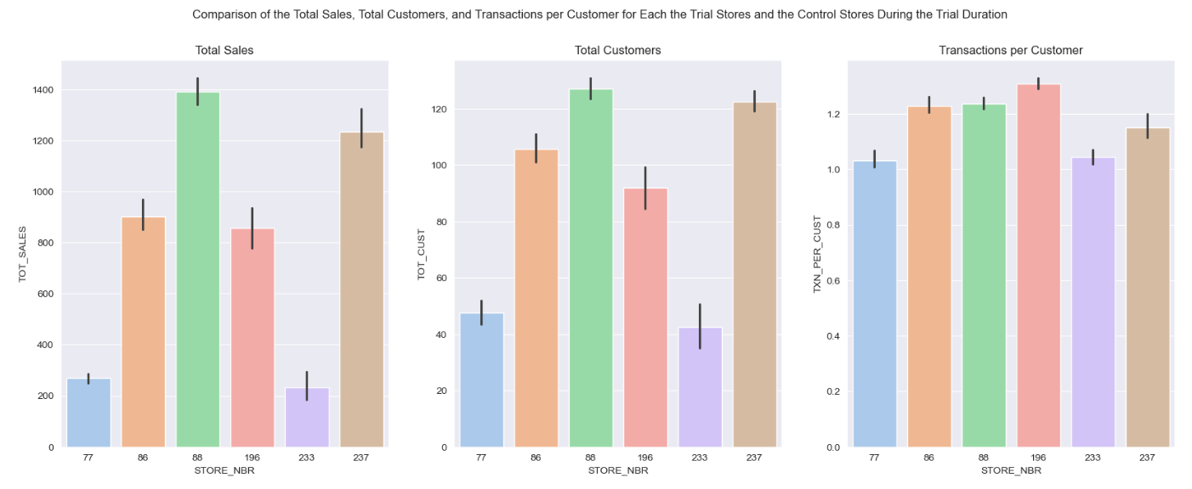
During trial period
Comparison of the Total Sales, Total Customers, and Transactions per Customer for Each the Trial Stores and the Control Stores During the Trial Duration.

Slide 14
Insights:
While the other trial stores performed the same as their corresponding control stores, we can see, however, that STORE_NBR 88 slightly out-performed its control store, STORE_NBR 237, in all attributes.
STORE_NBR 77 outperforms its control STORE_NBR 233 in sales and driver for this seems to be more customer acquisition rather than transaction per customer.
STORE_NBR 86 slightly outperform its control STORE_NBR 196 even with low transaction per customer by leveraging the more customers acquisition.
Due to the maximum difference in the total sales of all the trial stores, STORE_NBR 88 remains the best implementation of the trial.
Trial format of STORE_NBR 88 can be implemented on other stores for further analysis.

Slide 15
Conclusion:
Sales mainly came from Budget - older families, Mainstream - young singles/couples, and Mainstream - retirees. In total contributing 25% of sales revenue.
270 g packing of Tyrrells is most popular choice for customers.
Older and Young Family segment have the highest average purchase units per unique customer.
STORE_NBR 77 outperforms its control STORE_NBR 233 in sales by more customer acquisition.
STORE_NBR 86 slightly outperform its control STORE_NBR 196 by leveraging the more customers acquisition.
Due to the maximum difference in the total sales of all the trial stores, STORE_NBR 88 remains the best implementation of the trial.

